Slide 1
Decision Theory
(Utility based agents)

Slide 2
Agenda
Decision making with probabilistic uncertainty in actions
Decision theory (economics/business, psychology)
Markov Decision Process
Value Iteration
Policy Iteration

Slide 3
General Framework
An agent operates in some given finite state space
No explicit goal state; instead, states provide rewards (positive, negative, or null) that quantify in a single unit system what the agent gets when it visits this state (e.g., a bag of gold, a sunny afternoon on the beach, a speeding ticket, etc...)
Each action has several possible outcomes, each with some probability; sensing may also be imperfect
The agent’s goal is to plan a strategy (here, it is called a policy) to maximize the expected amount of rewards collected

Slide 4
Two Cases
Uncertainty in action only [The world is fully observable]
Uncertainty in both action and sensing [The world is partially observable]

Slide 5
Action Model
States s ∈ S
Action a:
a(s) = {(s₁,p₁), (s₂,p₂), ... , (s_{n},p_{n})}
probability distribution over possible successor states
[ ]
Markov assumption: The action model a(s) does not depend on what happened prior to reaching s

Slide 6
Starting very simple ...
s₀
S₀ describes many actual states of the real world. A₁ reaches s₁ in some states, s₂ in others, and s₃ in the remaining ones
If the agent could return to S₀ many times in independent ways and if at each time it executed A₁, then it would reach s₁ 20% of the times, s₂ 70% of the times, and s₃ 10% of the times
A₁
0.2
0.7
0.1
s₁
s₂
s₃

Slide 7
Introducing rewards ...
s₀
Assume that the agent receives rewards in some states (rewards can be positive or negative)
If the agent could execute A₁ in S₀ many times, the average (expected) reward that it would get is: U(S₀,A₁)= 100x0.2 + 50x0.7 + 70x0.1
= 20 + 35 + 7
= 62
A₁
0.2
0.7
0.1
s₁
s₂
s₃
100
50
70 ← rewards associated with states s₁, s₂, and s₃

Slide 8
... and a second action ...
s₀
U(S₀,A₁) = 62
U(S₀,A₂) = 78
If the agent chooses to execute A₂, it will maximize the average collected rewards
A₁
A₂
0.2
0.7
0.1
0.2 0.8
s₁
s₂
s₃
s₄
100
50
70 80

Slide 9
... and action costs
s₀
We may associate costs with actions, which are subtracted from the rewards
U(S₀,A₁) = 62 – 5 = 57
U(S₀,A₂) = 78 – 25 = 53
When in s₀, the agent will now gain more on the average by executing A₁ than by executing A₂
-5
-25
A₁
A₂
0.2
0.7
0.1
0.2 0.8
s₁
s₂
s₃
s₄
100
50
70 80

Slide 10
A complete (but still very simple) example: Finding Juliet
A robot, Romeo, is in Charles’ office and must deliver a letter to Juliet
Juliet is either in her office, or in the conference room. Each possibility has probability 0.5
Traveling takes 5 minutes between Charles’ and Juliet’s office, 10 minutes between Charles’ or Juliet’s office and the conference room
To perform his duties well and save battery, the robot wants to deliver the letter while minimizing the time spent in transit
Juliet’s off.
5min
Charles’ off.
10min
10min
Conf. room

Slide 11
States and Actions in Finding-Juliet Problem
States:
S₀: Romeo in Charles’ office
S₁: Romeo in Juliet’s office and Juliet here
S₂: Romeo in Juliet’s office and Juliet not here
S₃: Romeo in conference room and Juliet here
S₄: Romeo in conference room and Juliet not here
In this example, S₁ and S₃ are terminal states
Actions:
GJO (go to Juliet’s office)
GCR (go to conference room)
The uncertainty in an action is directly linked to the uncertainty in Juliet’s location

Slide 12
State/Action Tree
s₀
Juliet’s off.
5min
Charles’ off.
10min
GCR
GJO
10min
Conf. room
-10
-5
0.5
0.5
0.5
0.5
s₄
s₃
s₂
s₁
100
100
In this example, only the terminal states give positive rewards (say, 100)
The cost of each action (~ negative reward of reached state) is its duration
GJO
GCR
-10
-10
1.0
1.0
s₁
s₃
100
100

Slide 13
Forward View of Rewards
s₀
Juliet’s off.
5min
0
Charles’ off.
10min
GCR
GJO
10min
Conf. room
10
5
s₄
s₃
s₂
s₁
-10
90
-5
95
In this example, only the terminal states give positive rewards (say, 100)
The cost of each action (~ negative reward of reached state) is its duration
GJO
GCR
10
10
s₁
s₃
80
85

Slide 14
Backward View of Rewards
s₀
Juliet’s off.
5min
Charles’ off.
10min
GCR
GJO
10min
Conf. room
10
5
s₄
s₃
s₂
s₁
100
100
The computation of U (utility) at each non-terminal node resembles backing up the values of an evaluation function in adversarial search
GJO
GCR
10
10
s₁
s₃
100
100

Slide 15
Backward View of Rewards
s₀
Juliet’s off.
5min
Charles’ off.
10min
GCR
GJO
10min
Conf. room
10
5
s₄
s₃
s₂
s₁
100
100
The computation of U (utility) at each non-terminal node resembles backing up the values of an evaluation function in adversarial search
GJO
GCR
10
10
90
90
s₁
s₃
100
100

Slide 16
Backward View of Rewards
s₀
Juliet’s off.
5min
Charles’ off.
10min
GCR
GJO
10min
Conf. room
10
5
s₄
s₃
s₂
s₁
90
100
90
100
The computation of U (utility) at each non-terminal node resembles backing up the values of an evaluation function in adversarial search
GJO
GCR
10
10
90
90
s₁
s₃
100
100

Slide 17
Backward View of Rewards
s₀
Juliet’s off.
5min
U(s₀,GCR) = 0.5*90+0.5*100-5
10min
Charles’ off.
GCR
GJO
10min
Conf. room
85
10
90
5
U(s₀,GJO) = 0.5*90+0.5*100-10
s₄
s₃
s₂
s₁
90
100
90
100
The computation of U (utility) at each non-terminal node resembles backing up the values of an evaluation function in adversarial search
GJO
GCR
10
10
90
90
s₁
s₃
100
100

Slide 18
Backward View of Rewards
s₀
Juliet’s off.
U(s₀) = max{85, 90}
90
5min
Charles’ off.
10min
GCR
GJO
10min
Conf. room
85
10
90
5
s₄
s₃
s₂
s₁
90
100
90
100
The computation of U (utility) at each non-terminal node resembles backing up the values of an evaluation function in adversarial search
The best choice in s₀ is to select GJO
GJO
GCR
10
10
90
90
s₁
s₃
100
100

Slide 19
Generalization
Inputs:
Initial state s₀
Action model P(s’|s,a)
Reward R(s) collected in each state s
A state is terminal if it has no successor
Starting at s₀, the agent keeps executing actions until it reaches a terminal state
Its goal is to maximize the expected sum of rewards collected (additive rewards)
Assume for a while that the same state can’t be reached twice (no cycles) [finite state space → finite state/action tree]

Slide 20
Policies
A policy π(s) is a map that gives an action to take if the agent finds itself in state s
The expected sum of rewards accumulated by an agent that follows policy π starting at s is
U^{π}(s) = E[Σ_{t} R(S_{t})]
Where S_{t} is the random variable denoting the state that the agent will be in at time t (S₀=s)
[Forward view]

Slide 21
Policies
A policy π(s) is a map that gives an action to take if the agent finds itself in state s
The expected sum of rewards accumulated by an agent that follows policy π starting at s is
U^{π}(s) = E[Σ_{t} R(S_{t})]
Where S_{t} is the random variable denoting the state that the agent will be in at time t (S₀=s)
[Forward view]
We want to find the policy π* that maximize U^{π}(s)
Define the true utility U(s)=U^{π*}(s)

Slide 22
From Utility to Policies
If we knew U(s), every time the agent found itself in state s, it could simply take the action: π(s) = arg max_{a} Σ_{s’∈S} P(s’|s,a)U(s’)
Since U(s’) measures the expected sum of collected rewards in the future state s’, it makes sense to pick the action that maximizes the expectation of U(s’)
In fact, this gives the optimal policy

Slide 23
Utility of a State
The utility of a state s measures its desirability:
If s is terminal: U(s) = R(s)
If s is non-terminal: U(s) = R(s) + max_{a∈Appl(s)}Σ_{s’∈Succ(s,a)}P(s’|s,a)U(s’)
[the reward of s augmented by the expected sum of rewards collected in future states]

Slide 24
U(s) = R(s) + max_{a∈Appl(s)}Σ_{s’∈Succ(s,a)} P(s’|s,a)U(s’)
Appl(s) is the set of all actions applicable to state s
Succ(s,a) is the set of all possible states after applying a to s
P(s’|s,a) is the probability of being in s’ after executing a in s
[the reward of s augmented by the expected sum of rewards collected in future states]

Slide 25
Utility of a State
The utility of a state s measures its desirability:
If s is terminal: U(s) = R(s)
If s is non-terminal: U(s) = R(s) + max_{a∈Appl(s)}Σ_{s’∈Succ(s,a)}P(s’|s,a)U(s’)
[the reward of s augmented by the expected sum of rewards collected in future states]
There is no cycle

Slide 26
U(s) = R(s) + max_{a∈Appl(s)}Σ_{s’∈Succ(s,a)} P(s’|s,a)U(s’)

Slide 27
Utility with Action Costs
U(s) = R(s) + max_{a∈Appl(s)}[-cost(a) + Σ_{s’∈Succ(s,a)}P(s’|s,a)U(s’)]
Cost of action a + expected rewards collected in future states
Bellman equation

Slide 28
Issues
What if the set of states reachable from the initial state is too large to be entirely generated (e.g., there is a time limit)?
How to deal with cycles (states that can be reached multiple times)?

Slide 29
What if the set of states reachable from the initial state is too large to be entirely generated (e.g., there is a time limit)?
Expand the state/action tree to some depth h
Estimate the utilities of leaf nodes [Reminiscent of evaluation function in game trees]
Back-up utilities as described before (using estimated utilities at leaf nodes)

Slide 30
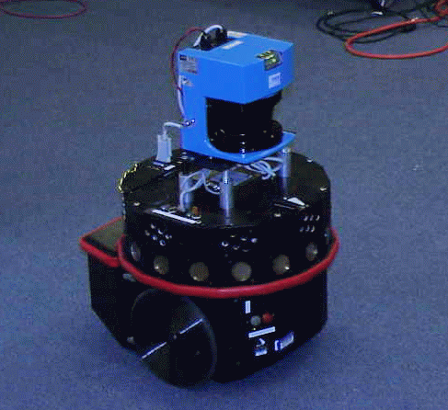
Target-Tracking Example
The robot must keep a target in its field of view
The robot has a prior map of the obstacles
But it does not know the target’s trajectory in advance
robot
target

Slide 31
Target-Tracking Example
Time is discretized into small steps of unit duration
At each time step, each of the two agents moves by at most one increment along a single axis
The two moves are simultaneous
The robot senses the new position of the target at each step
The target is not influenced by the robot (non-adversarial, non-cooperative target)
robot
target

Slide 32
Time-Stamped States (no cycles possible)
([i,j], [u,v], t)
([i+1,j], [u,v], t+1)
([i+1,j], [u-1,v], t+1)
([i+1,j], [u+1,v], t+1)
([i+1,j], [u,v-1], t+1)
([i+1,j], [u,v+1], t+1)
right
State = (robot-position, target-position, time)
In each state, the robot can execute 5 possible actions : {stop, up, down, right, left}
Each action has 5 possible outcomes (one for each possible action of the target), with some probability distribution
[Potential collisions are ignored for simplifying the presentation]

Slide 33
Rewards and Costs
The robot must keep seeing the target as long as possible
Each state where it does not see the target is terminal
The reward collected in every non-terminal state is 1; it is 0 in each terminal state [→ The sum of the rewards collected in an execution run is exactly the amount of time the robot sees the target]
No cost for moving vs. not moving

Slide 34
Expanding the state/action tree
...
horizon 1
horizon h

Slide 35
Assigning rewards
Terminal states: states where the target is not visible
Rewards: 1 in non-terminal states; 0 in others
But how to estimate the utility of a leaf at horizon h?
...
horizon 1
horizon h

Slide 36
Estimating the utility of a leaf
...
d
robot
target
Compute the shortest distance d for the target to escape the robot’s current field of view
If the maximal velocity v of the target is known, estimate the utility of the state to d/v [conservative estimate]
horizon 1
horizon h

Slide 37
Selecting the next action
Compute the optimal policy over the state/action tree using estimated utilities at leaf nodes
Execute only the first step of this policy
Repeat everything again at t+1… (sliding horizon)
...
Real-time constraint: h is chosen so that a decision can be returned in unit time [A larger h may result in a better decision that will arrive too late !!]
horizon 1
horizon h

Slide 38
Pure Visual Servoing
Notes:
FOR EXAMPLE<
ALWAYS KEEP TARGET AT A FIXED DISTANCE DIRECTLY IN FORNT OF OBSERVER
NOT ENOUGH TO JUST USE PURE SERVOING
KNOW TARGET’S NXT MOVE
AND PLAN MOTION

Slide 39
Computing and using a policy
Notes:
ALSO ANALYSIS FOR TARGET MOTION AND PLAN MOTION

Slide 40
In this target-tracking example stamping states by time is a “trick” to avoid cycles
If the probability distribution of the target’s possible moves at each time step does not depend on past history (Markov assumption), then the best move of the robot at each time step should only depend on the robot’s and target’s current positions, not on time
To find this best move, we must remove the time stamp and handle cycles appropriately

Slide 41
Robot Navigation Example
3
square(3,2)
2
1
1
2
3
4
The robot (shown ) lives in a world described by a 4x3 grid of squares with square (2,2) occupied by an obstacle
A state is defined by the square in which the robot is located: (1,1) in the above figure
→ 11 states

Slide 42
Action (Transition) Model
3
U brings the robot to:
(1,2) with probability 0.8
(2,1) with probability 0.1
(1,1) with probability 0.1
2
1
1
2
3
4
In each state, the robot’s possible actions are {U, D, R, L}
For each action:
With probability 0.8 the robot does the right thing (moves up, down, right, or left by one square)
With probability 0.1 it moves in a direction perpendicular to the intended one
If the robot can’t move, it stays in the same square
[This model satisfies the Markov condition]

Slide 43
Action (Transition) Model
3
L brings the robot to:
(1,1) with probability 0.8 + 0.1 = 0.9
(1,2) with probability 0.1
2
1
1
2
3
4
In each state, the robot’s possible actions are {U, D, R, L}
For each action:
With probability 0.8 the robot does the right thing (moves up, down, right, or left by one square)
With probability 0.1 it moves in a direction perpendicular to the intended one
If the robot can’t move, it stays in the same square
[This model satisfies the Markov condition]

Slide 44
Terminal States, Rewards, and Costs
-.04
-.04
-.04
+1
3
-.04
-.04
-1
2
1
-.04
-.04
-.04
-.04
1
2
3
4
Two terminal states: (4,2) and (4,3)
Rewards:
R(4,3) = +1 [The robot finds gold]
R(4,2) = -1 [The robot gets trapped in quick sands]
R(s) = -0.04 in all other states
Actions have zero cost [actually, they are encoded in the negative rewards of non-terminal states]

Slide 45
State Utilities
0.81
0.87
0.92
+1
3
0.76
0.66
-1
2
1
0.71
0.66
0.61
0.39
1
2
3
4
The utility of a state s is the maximal expected amount of reward that the robot will collect from s and future states by executing some action in each encountered state, until it reaches a terminal state (infinite horizon)
Under the Markov and infinite horizon assumptions, the utility of s is independent of when and how s is reached [It only depends on the possible sequences of states after s, not on the possible sequences before s]

Slide 46
(Stationary) Policy
+1
+1
3
3
-1
-1
2
2
1
1
1
2
3
4
1
2
3
4
A stationary policy is a complete map Π: state → action
For each non-terminal state it recommends an action, independent of when and how the state is reached
Under the Markov and infinite horizon assumptions, the optimal policy Π* is necessarily a stationary policy [The best action in a state does not depends on the past]

Slide 47
(Stationary) Policy
+1
+1
3
3
-1
-1
2
2
1
1
1
2
3
4
1
2
3
4
A stationary policy is a complete map P: state → action
For each non-terminal state it recommends an action, independent of when and how the state is reached
Under the Markov and infinite horizon assumptions, the optimal policy Π* is necessarily a stationary policy [The best action in a state does not depends on the past]
Finding Π* is called an observable Markov Decision Problem (MDP)
The optimal policy tries to avoid “dangerous” state (3,2)

Slide 48
Execution of Optimal Policy
Repeat:
s ← sensed state
If s is terminal then exit
a ← Π*(s)
Perform a
(Reactive agent algorithm)
+1
3
-1
2
1
1
2
3
4
Let the robot executes Π* many times from the same state s
Each run produces a sequence of states with some probability
Each possible sequence collects a certain amount of reward
The utility of s is the average amount of reward collected over the successive executions of Π*
It is maximal over all policies

Slide 49
Optimal Policies for Various R(s)
+1
+1
-1
-1
R(s) = -0.04
R(s) = -2
+1
+1
-1
-1
R(s) = -0.01
R(s) > 0

Slide 50
Defining Equations
+1
3
-1
2
1
1
2
3
4
If s is terminal:
U(s) = R(s)
If s is non-terminal:
U(s) = R(s) + max_{a∈Appl(s)}Σ_{s’∈Succ(s,a)}P(s’|a,s)U(s’) [Bellman equation]
Π*(s) = arg max_{a∈Appl(s)}Σ_{s’∈Succ(s,a)}P(s’|a,s)U(s’)

Slide 51
Defining Equations
+1
3
The utility of s depends on
the utility of other states s’
(possibly, including s), and
vice versa
-1
2
1
1
2
3
4
If s is terminal:
U(s) = R(s)
If s is non-terminal:
U(s) = R(s) + max_{a∈Appl(s)}Σ_{s’∈Succ(s,a)}P(s’|a.s)U(s’)
[Bellman equation]
Π*(s) = arg max_{a∈Appl(s)}Σ_{s’∈Succ(s,a)}P(s’|a.s)U(s’)
The equations are non-linear

Slide 52
Value Iteration Algorithm
0
0
0
+1
0.81
0.87
0.92
+1
3
3
0
0
-1
0.76
0.66
-1
2
2
1
0
0
0
0
1
0.71
0.66
0.61
0.39
1
2
3
4
1
2
3
4
Initialize the utility of each non-terminal states to U₀(s) = 0
For t = 0, 1, 2, ... do U_{t+1}(s) = R(s) + max_{a∈Appl(s)}Σ_{s’∈Succ(s,a)}P(s’|a,s)U_{t}(s’) for each non-terminal state s

Slide 53
Value Iteration Algorithm
0.81
0.87
0.92
+1
+1
3
3
0.76
0.66
-1
-1
2
2
1
0.71
0.66
0.61
0.39
1
1
2
3
4
1
2
3
4
Initialize the utility of each non-terminal states to U₀(s) = 0
For t = 0, 1, 2, ... do U_{t+1}(s) = R(s) + max_{a∈Appl(s)}Σ_{s’∈Succ(s,a)}P(s’|a,s)U_{t}(s’) for each non-terminal state s
For each non-terminal state s do Π*(s) = arg max_{a∈Appl(s)}Σ_{s’∈Succ(s,a)}P(s’|a,s)U(s’)

Slide 54
Value Iteration Algorithm
0.81
0.87
0.92
+1
+1
3
3
0.76
0.66
-1
-1
Value iteration is essentially the same as computing the best move from each state using a state/action tree expanded to a large depth h (with estimated utilities of the non-terminal leaf nodes set to 0)
By doing the computation for all states simultaneously, it avoids much redundant computation
2
2
1
0.71
0.66
0.61
0.39
1
1
2
3
4
1
2
3
4
Initialize the utility of each non-terminal states to U₀(s) = 0
For t = 0, 1, 2, ... do U_{t+1}(s) = R(s) + max_{a∈Appl(s)}Σ_{s’∈Succ(s,a)}P(s’|a,s)U_{t}(s’) for each non-terminal state s
For each non-terminal state s do Π*(s) = arg max_{a∈Appl(s)}Σ_{s’∈Succ(s,a)}P(s’|a,s)U(s’)

Slide 55
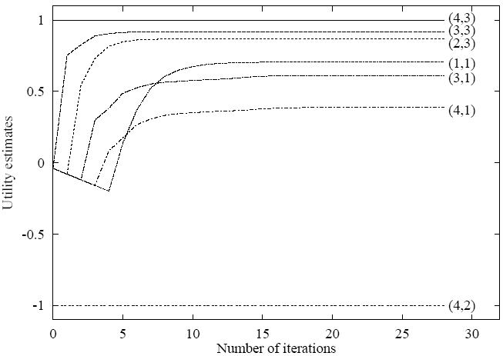
Convergence of Value Iteration
0.81
0.87
0.92
+1
3
0.76
0.66
-1
2
1
0.71
0.66
0.61
0.39
1
2
3
4

Slide 56
Convergence of Value Iteration
If:
The number of states is finite
There exists at least one terminal state that gives a positive reward and is reachable with non-zero probability from every other non-terminal state (connectivity of the state space)
R(s) ≤ 0 at every non-terminal state
The cost of every action is ≥ 0
Then value iteration converges toward an optimal policy if we wait long enough
But what if the above conditions are not verified? [E.g., “taxi-driver” example, where there is no terminal state]

Slide 57
Discount Factor
Idea: Prefer short-term rewards over long-term ones
If the execution of a policy from a state s₀ produces the sequence s₀, s₁, ..., s_{n} of states, then the amount of collected reward is R(s₀) + γR(s₁) + ... + γ^{n}R(s_{n}) = Σ_{i=0,...,n} γ^{i}R(s_{i}) where 0 < γ < 1 is a constant called the discount factor
The defining equation of the utilities becomes: U(s) = R(s) + γ max_{a∈Appl(s)}Σ_{s’∈Succ(s,a)}P(s’|a,s)U (s’)
Using a discount factor guarantees the convergence of V.I. in finite state spaces, even if there is no terminal states and reward/cost values for each state/action are arbitrary (but finite) [Intuition: The nodes in the state/action tree get less and less important as we go deeper in the tree]
In addition, using discount factor provides a convenient test to terminate V.I.(see R&N, p 652-654)

Slide 58
Remarks
Value iteration may give the optimal policy Π* long before the utility values have converged
There are only a finite number of possible policies
→ Policy iteration algorithm

Slide 59
Policy Iteration Algorithm
Pick any policy π
changed? ← true
Repeat until ¬changed?
[Policy evaluation] Solve the linear system U_{π}(s) = R(s) + γ Σ_{s’∈Succ(s,Π(s))}P(s’|s,π(s))U_{π}(s’)
changed? ← false
[Policy improvement] For each state s do
If max_{a∈Appl(s)}Σ_{s’∈Succ(s,a)}P(s’|s,a)U_{π}(s’) > Σ_{s’∈Succ(s,π(s))}P(s’|s,a)U_{π}(s’) then
π(s) ← arg max_{a∈Appl(s)}Σ_{s’∈Succ(s,a)}P(s’|s,a)U_{π}(s’)
changed? ← true
If ¬changed? then return π
often a sparse one

Slide 60
Policy Evaluation via Matrix inversion
U_{π}(s) = R(s) + γ Σ_{s’∈Succ(s,π(s))}P(s’|s, π(s))U_{π}(s’)
Put an ordering on states
U_{π}(s) is a vector u = [U_{π}(s₁),…, U_{π}(s_{n})]
R(s) is a vector r = [R(s₁),…,R(s_{n})]
Σ_{s’∈Succ(s,π(s))}P(s’|s, π(s))U_{π}(s’) is the result of a matrix multiplication T_{π}u
T_{π}[i,j] = P(s_{i}|s_{j}, π(s_{j})) (transition matrix)
=> u = r + γ T_{π}u
=> (I - γ T_{π}) u = r (I: identity matrix)
=> u = (I - γ T_{π})⁻¹ r

Slide 61

Application to Medical Needle Steering

Slide 62
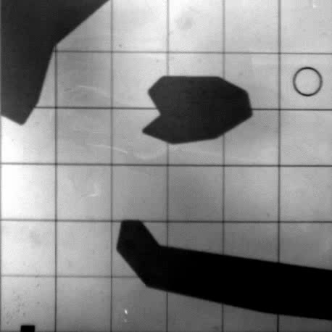
Steerable needles (Alterovitz et al)
Flexible needle
Forces on bevel tip provide guidance inside tissue
But tissue is inhomogenous and deforming, so we can’t predict exactly how the needle will move!

Slide 63
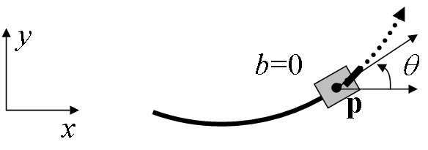
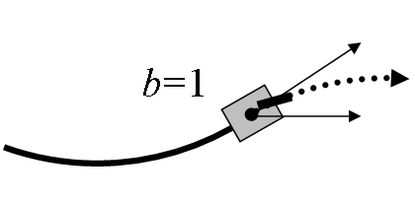
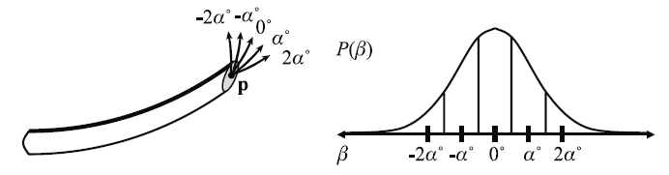
Needle Steering in 2D
Bevel up vs. bevel down (ccw or cw rotation)
Markov uncertainty model

Slide 64
Maximizing Probability of Success
Formulate an MDP with
R(s) = 1 if s is a goal node
R(s) = 0 if s is a terminal, non-goal node
Costs = 0
In the state space (x,y,θ)
Discretize via random sampling

Slide 65
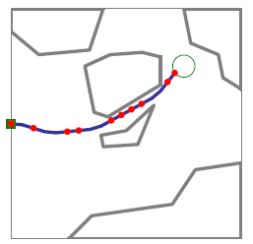
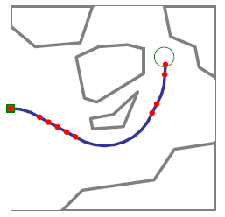
MDP results
Minimize path length
Probability of success: 37%
Maximize success rate
Probability of success: 74%

Slide 66
Finite vs. Infinite Horizon
If the agent must maximize the expected amount of collected award within a maximum number of steps h (finite horizon), the optimal policy is no longer stationary → Stamp states by time (step number) just as in the target-tracking example Compute the optimal policy over the state/action tree expanded to depth h, in which all leaf states are now terminal
[E.g., taxi driver at the end of his/her work day]

Slide 67
Next Time
Reinforcement Learning
R&N 21.1-2

